Slide 1
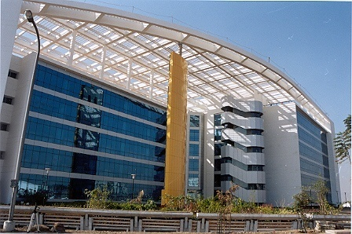
JAX-WS
Trainer: Mazahir Clipwala
Oct 2014

Slide 2
Agenda – Day 1
Before You Begin
What is a Web Service (WS)?
Web Service Terminology
Write a WS client
Adding Input Arguments
Service first (bottom-up) and Contract first (top-down)
Understanding the WSDL

Slide 3
DAY 1 – Before You Begin
You need to have a basic understanding of:
Java
XML
You need the following to get started:
JRE 6 and above
Text Editor or an IDE
MANDATORY
WILLING TO LEARN
ABSOLUTELY MANDATORY

Slide 4
DAY 1 – What is a Web Service?
Web service is a service over the network/internet.
Woody
Buzz
Application “A”
- getCustomers ()
Application “B”
- displayCustomers()
Web Service
SOAP
REST
JAX-WS
Java API for XML WS
JAX-RS
Java API for RESTful WS
Old
New

Slide 5
DAY 1 – Web Service Terminology
WSDL (what) stands for Web Service Description Language - it is an XML based interface/contract definition language used for describing the functionality offered by a WS. A WSDL file provides a readable description of how the service can be called, what parameters it expects and what data structure it returns. WSDL can be hand-written; however it can be generated via tools too.
UDDI (where) stands for Universal Description Discovery and Integration - it is yellow pages for the WS or more popularly called a registry by which business worldwide can list themselves on the internet and a mechanism to register and locate WS applications.
SOAP (how) stands for Simple Object Access Protocol - it is a protocol specification for exchanging structured information. The format used is XML. So a string in Java can be totally different than the string in C++, SOAP is a protocol that defines a format which can be understood by all the technologies.
SEI (who) stands for Service Endpoint Interface - it is used for converting a client request to a SOAP message.
JAXB stands for Java Architecture for XML Binding - it constitutes a convenient framework for processing XML documents.

Slide 6
DAY 1 – Write a WS Client
Free WS available on the internet
http://www.webservicex.net/WS/WSDetails.aspx?CATID=12&WSID=64
This WS is called GeoIPService and it enables to look up countries by IP address/Context.
An SEI, which acts as a service for the endpoint interface has to be generated. The SEI can be generated automatically by the wsimport tool provided by Java SE. You do not need J2EE for this.
Below are the variations of the wsimport usage:
wsimport <<WSDL_URI>>
the command will generate java classes for the WSDL document.
wsimport -keep -s <<directory to place the generated source files>> <<WSDL_URI>>
the command will generate the java source and compiled classes for the WSDL document.

Slide 7
DAY 1 – Service first (bottom-up) and Contract first (top-down)
Service First | Contract First
Also known as bottom-up. | Also known as top-down.
Implementation/Service is written first and then the contract is generated. | Contract is written first and then the implementation/service is generated.
Easy to learn. | Bit hard to learn.
The contract changes based on the implementation changes. | Contract remains static and the implementation can change.
Clients will be affected based on the contract changes. | Clients will not be affected when the implementation changes.
Code first and XML later. | XML first and code later.
WE WILL LEARN SEVICE FIRST

Slide 8
DAY 1 – Understanding the WSDL
service - define the service that is exposed to the world. Contains the following element:
port – has the name of the port and the binding reference to the binding element.
binding - defines the port. Has reference to the portType element. Contains the following element:
binding - has transport used for the SOAP binding.
portType – defines all the operations in the WS. Has the following element(s):
operation - the operation that the WS provide. There can be multiple operations. Contains the following elements:
input - specifies the input parameter for the operation. Only one input entry per operation. Has reference to the message element.
output - specifies the output parameter for the operation. Only one output entry per operation. Has reference to the message element.
message – has reference to the simple or the complex types.
types - used for defining complex data type. These types are referenced in portType and message elements.

Slide 9


Thank you

